Slide 1


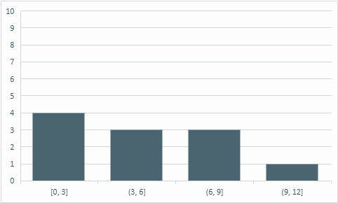
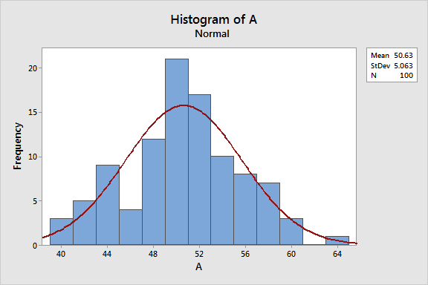
Histogram Analysis
G H RAISONI COLLEGE OF ENGINEERING AND MANAGAMENT, PUNE
TAE-I ( Poster Presentation and Submission)
Histograms are graphs that display the distribution of your continuous data. They are fantastic exploratory tools because they reveal properties about your sample data in ways that summary statistics cannot. For instance, while the mean and standard deviation can numerically summarize your data, histograms bring your sample data to life.
A frequency distribution shows how often each different value in a set of data occurs.It looks very much like a bar chart, but there are important differences between them. This helpful data collection and analysis tool is considered one of the seven basic quality tools.
The Histogram tool is part of the Data Analysis Toolpak. It may not initially appear on your ribbon, but is a cinch to install.
Histograms are useful exploratory data visualizations for spotting outliers, skew, bimodality, and other shape features in the distribution as well as for comparing subgroups in the data. The presence of strong skewness or outliers should lead researchers to investigate the use of median.
Even if no histograms are included in a final publication, they are a quick and indispensable tool to help researchers catch potential problems in the data and reveal interesting features.

Slide 2
G.H.Raisoni College of Engineering and Management,Wagholi Pune,412207
(An Autonomous Institute Affiliated to SPPU)
TAE Assesment Sheet for FY Btech
SR.NO | ROLL NO | DIVISION | NAME OF THE STUDENT | TAE NO | POSTER/PRESENTATION
Rubrics For Assesement
CATEGORY | Contents | Presentation | Spelling and pronunciation | Oral Presentation | TOTAL
MARKS | 2 | 1 | 1 | 1 | 5
 |  |  | Teacher sign (With name and date)

